Slide 1

Keylogger Detection Tool
Karishma Sk
CYBER SECURITY STUDENT

Slide 2

Cyber Security Threats
Understanding keyloggers as a significant cyber security risk today
As cyber security threats escalate globally, it's crucial to recognize the dangers posed by keyloggers. These malicious programs silently record keystrokes, enabling attackers to steal sensitive information, such as passwords and personal data. Detecting these threats is vital in maintaining system security and safeguarding user information.

Slide 3




Project Objectives
Monitor Processes
Detect Programs
Alert Users
Understand Malware
Continuously track running system activities.
Identify suspicious activities related to keyloggers.
Notify users of potential security threats.
Learn basic techniques for malware detection.

Slide 4


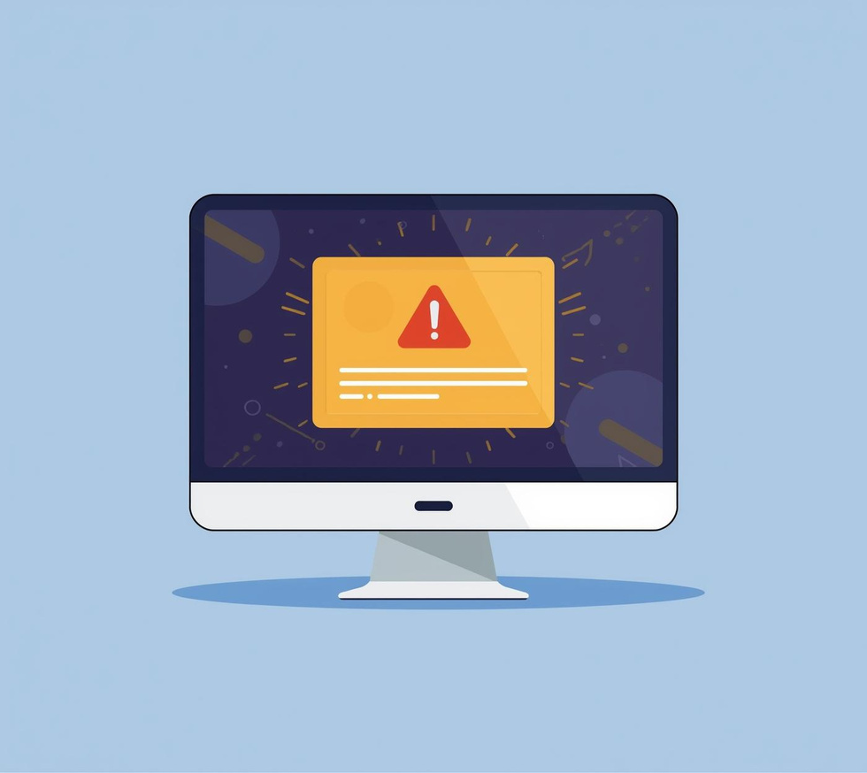
Working Methodology
Scan Processes
Compare Keywords
Flag Matches
Continuously monitors active processes in real-time.
Matches suspicious keywords against running processes.
Alerts users when suspicious activities are detected.

Slide 5


Tools & Technologies
Programming Language
The project is built using Python programming.
Libraries Used
psutil efficiently monitors system processes.

Slide 6
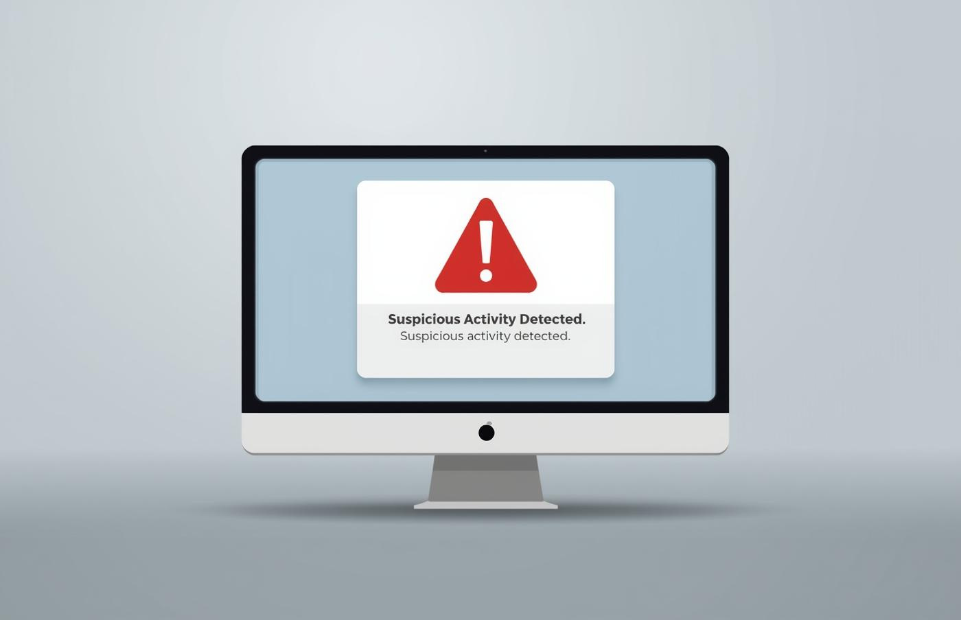
Project Output and Results
Security Alerts
Alerts notify users of detected suspicious processes.

Slide 7


Conclusion
Ethical Learning
Promotes understanding of keylogger detection techniques.
Future Enhancements
Integrates advanced machine learning methodologies for detection.

